Slide 1
109 Data Structure the 1st Homework

Slide 2
2D-Maze(30%)
Find the exit of the maze.
Input:
The first row only contains an integer n indicates the size of the maze is n*n.
For the next n rows, there are n characters separated by a space.
Characters∈ {O,S,F,X} indicate the content of the maze.
O : You can pass through this way.
S : Start point (exist for sure)
F : End point (exist for sure)
X : Wall (can not pass)

Slide 3
2D-Maze(30%)
example :
10
X O X O O O O O X X
O O X O O O O O O X
O O O O X X O O O O
O O X O F O O O O X
O X O O X X O O O X
O O O O O O X O O O
X O O O X O O O S X
O O O O O O X X X O
X X O O X O O O O O
O O O X X O X X O O

Slide 4
2D-Maze(30%)
Four directions: NESW
1 cost per movement.
1)Find a path from S to F and print the output graph. (15%)
If there’s no answer, please print corresponding message.
Use * to replace the path you go through.
2)Find the shortest path. (15%)
If you did it, please print the length of the shortest path.

Slide 5
2D-Maze(30%)
Output of the example：
X O X O O O O O X X
O O X O O O O O O X
O O O O X X O O O O
O O X O * * * O O X
O X O O X X * * O X
O O O O O O X * * O
X O O O X O O O * X
O O O O O O X X X O
X X O O X O O O O O
O O O X X O X X O O
Path length: 7

Slide 6
Format of the File
input file : test.txt
Just print the output in the prompt.
No test cases in this question. Find out the edge cases yourself.

Slide 7
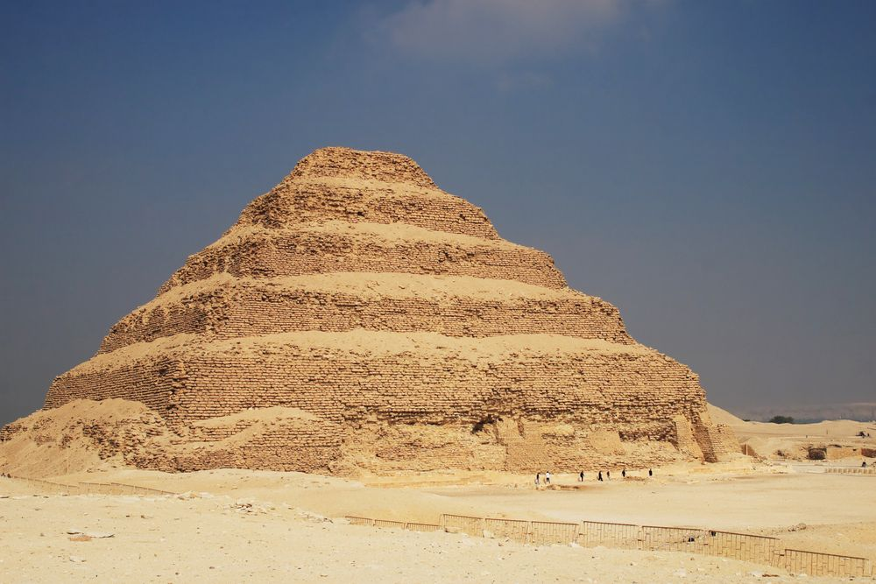

Surmount the Pyramid(70%)
“There are only two creatures who can surmount the pyramids--the eagle and the snail.”
The snail enters a pyramid from the bottom of the pyramid. Its goal is to go to the top of the pyramid.
However, there are so many traps that the snail has to overcome carefully.

Slide 8
Surmount the Pyramid(70%)
input：
No longer an integer n indicates the size of the maze.
n = the size of the 1st floor of the pyramid. (n < 14 and n is odd)
There will be k = n//2 + 1 floors in the pyramid (e.g. n=5, 3 floors in the pyramid.)
The first n rows will be n characters separated by space indicate the content of the 1st floor.
The next n-2k rows will be n characters separated by space indicate the content of the content of the (k-1)-th floor.
When k = n//2+1, 1 character F indicates the endpoint. (The top floor of the pyramid.)

Slide 9
Surmount the Pyramid(70%)
O, X, S：Refer to the previous question.
F : End point (in the top floor of the pyramid for sure.)
U：You can go to the upper layer of the pyramid here.
You can also just pass like this is an O character.
D：You can go to the lower layer of the pyramid here.
You can also just pass like this is an O character.
T：Trap, the snail needs 3 steps to pass here while 1 step is needed for O.

Slide 10
Surmount the Pyramid(50%)
input (blue character indicates the range of the upper layer)
S O O O O
O O O O O
O O O O O
O U O O O
O O O O O
O O O
O U O
O O O
F

Slide 11
Surmount the Pyramid(70%)
Six directions: NESW and up/down.
1 cost per movement in {O, U, D, S, F}.
3 cost per movement in T.
1)Find the shortest path from S to F and print the output graph (30%).

Slide 12
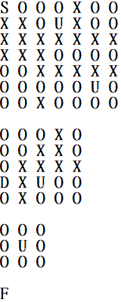
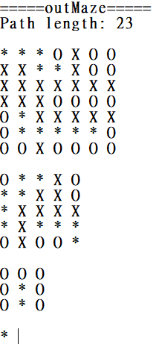
Surmount the Pyramid(70%)
example :

Slide 13
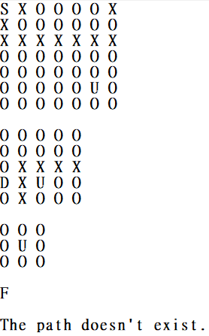
Surmount the Pyramid(70%)
example :

Slide 14
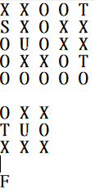
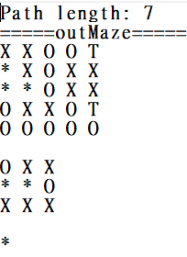
Surmount the Pyramid(70%)
example :

Slide 15
Format of the File
Input files are testi.txt, i∈{1,2,...,100}.
When scanning files, please inform me in the prompt so that I would know the program is running.
Please output the corresponding testi_ans.txt, i∈{1,2,...,100}
Time Limit: 8 seconds per data

Slide 16
Surmount the Pyramid(70%)
Everyone should have a second opportunity, snails are not exceptions.
Even if you go through different ways, it’s fine if you go to the endpoint finally.
2) You need to calculate the number of the paths that is 5 steps longer than the shortest path. (20%)
For example, the length of the shortest path is 20 steps.
In this case, you need to calculate the number of paths which are less than 25 steps.

Slide 17
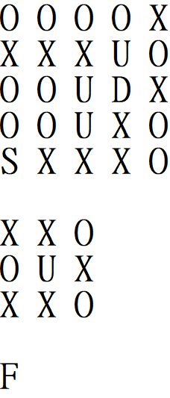
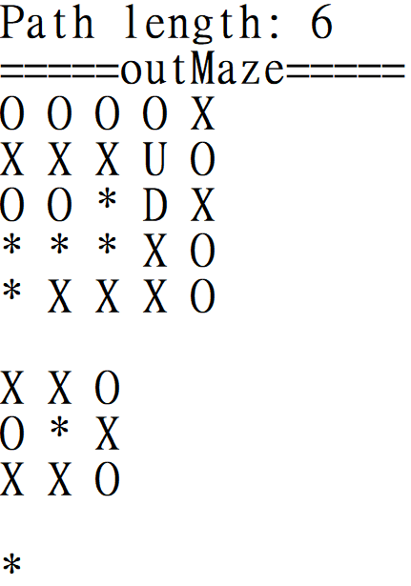
Surmount the Pyramid(70%)
For example:
Shortest path: 6, Limit: 11, The number of different paths: 4

Slide 18
Format of the File
Input files are testi.txt, i∈{1,2,...,100}.
When scanning files, please inform me in the prompt so that I would know the program is running.
Please output the corresponding output.txt.
Time Limit: 8 seconds per data

Slide 19
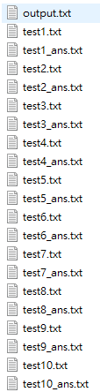
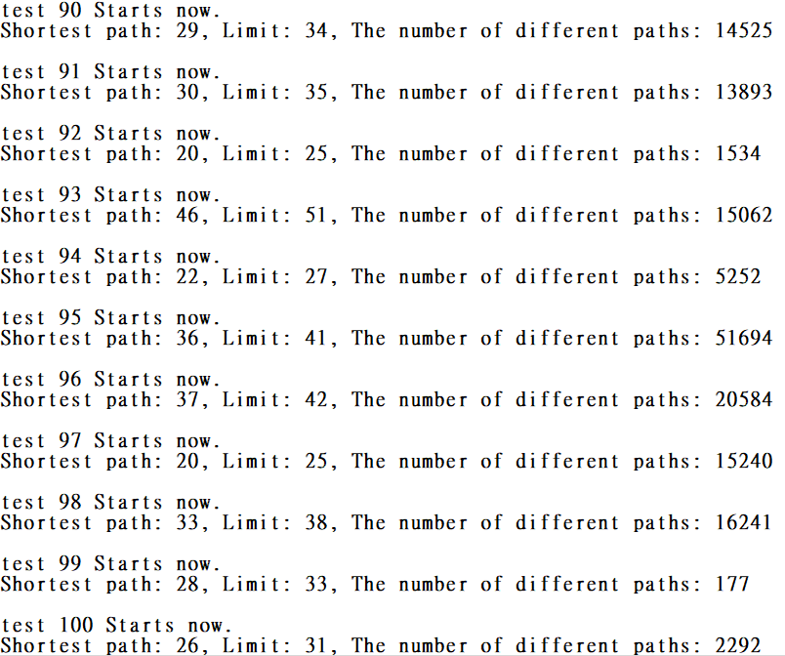
Format of the File

Slide 20

Surmount the Pyramid(70%)
The snail heard there’s an amazing secret in a certain road. It needs to find out no matter how.
3) You need to go to the endpoint while passing a specified path. Print the length of the shortest path and the number of all possible paths. (20%)
There will be some characters P in the maze. You need to pass through the path formed by P then reach the endpoint.
You can go upper/lower layer in P.

Slide 21
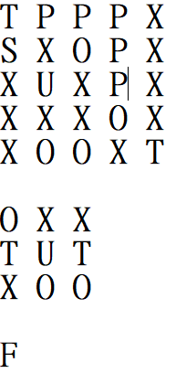
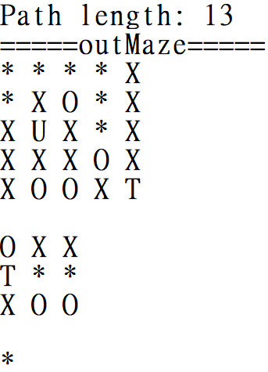
Surmount the Pyramid(70%)
Example (no need output graph in this question) :
The number of the paths : 2

Slide 22
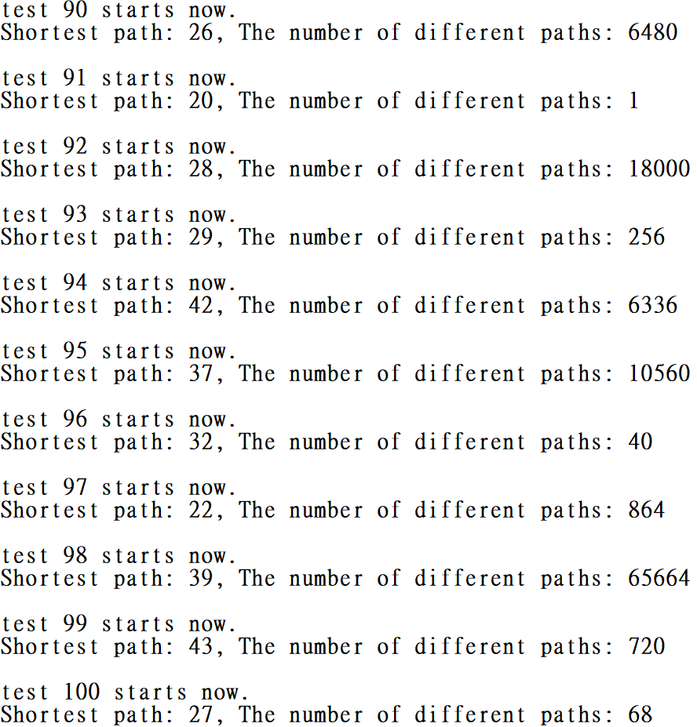
Surmount the Pyramid(70%)
Example of the output.txt:

Slide 23
Format of the File
Input files are testi.txt, i∈{1,2,...,100}.
When scanning files, please inform me in the prompt so that I would know the program is running.
Please output the corresponding output.txt.
Time Limit: 8 seconds per data

Slide 24
Reminders
Only accept C
Deadline : 2020/10/26 23:59, please be on time.
File name : [student ID]_[question No.(1or2)]-[sub question No.(1,2,3)].[file name extension]
e.g. 7109056193_1-1.c
If there are more than 1 file for 1 question, please give a readme.txt for me and let me know the meaning of each file.
No need to give me the output, I’ll execute your program.
Zip all your files and hand in on the i-learning, the file name is [student ID]_homework1.
Plagiarism is prohibited.
Dev-C++ 5.11 is used for checking this homework.

